Slide 1
PLC BASED AUTOMATIC CONTROLLING OF PARAMETERS USING LOGIC DIAGRAM
GUIDE:Ranjita.R
SUBJECT:PLC
PRESENTED BY: Sonika(1cr16ee081)
Sayyed sanobar(1cr16ee071)
Shailaja(1cr17ee415)

Slide 2
INTRODUCTION
The process of controlling water level of storage tank is demonstrated in PLC ladder logic program
3 modes of operation are programmed in
this example
Manual mode
Automatic mode
OFF mode

Slide 3
COMPONENTS USED:
INPUT DEVICES
OUTPUT DEVICES
MANUAL AND AUTO SWITCH
LOW LEVEL SENSOR SWITCH
HIGH LEVEL SENSOR SWITCH
MOTOR
ON AND OFF SWITCH
INDICATOR LAMPS

Slide 4
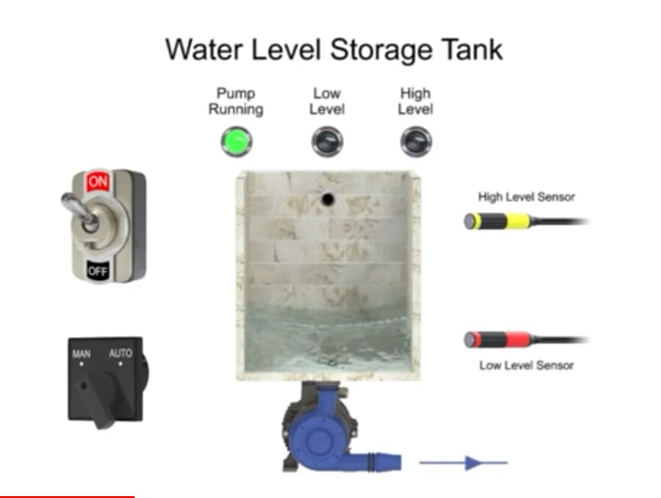

Slide 5
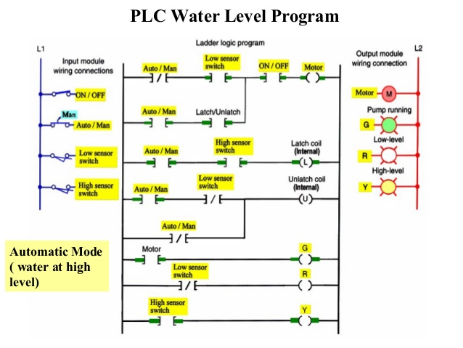

Slide 6
MANUAL MODE:
In manual mode program controls water level by monitoring the low sensor switch input.
AUTOMATIC MODE:
The automatic mode of operation is selected by turning the switch to auto. The program will control the discharge pump motor automatically by monitoring high and low sensor switch input.
OFF MODE:
By turning the on off switch to the off position in man or auto mode pump operation is disabled

Slide 7
CONCLUSION:
BY THE END OF THIS PROJECT WE WILL LEARN HOW TO PROGRAM IN PLC BY USING LOGIX PRO SOFTWARE
HOW TO DESIGN AUTOMATIC CONTROL OF ANY PARAMETER USING PLC

